Slide 1
DMJ Engineering Program Tooling
Netezza Inventory Scripts
Overview and Guidance
Jonathon Frost, Solution Architect
DMJ Engineering Program
jfrost@microsoft.com
Kuldeep Chauhan, Solution Architect
DMJ Engineering Program
kuldeep.chauhan@microsoft.com
Mitch van Huuksloot, Solution Architect
DMJ Engineering Program
mitch.van.huuksloot@microsoft.com
Mukesh Kumar, Program Manager
DMJ Engineering Program
mukeshku@microsoft.com

Slide 2
Overview of Scripts
Set of 4 inventory scripts that collect Netezza database, object, and schema data about the databases on in the Netezza environment.
Scripts are run from Netezza Linux command line.
Scripts output to .csv files that can be taken and processed by a custom Excel workbook to build aggregations and summaries of .csv contents.
Scripts and output help provide structured approach and process for customer Netezza migration workshops and assessments.

Slide 3

Objects and Schema Items Inventoried
Tables
External Tables
Procedures (Name, Signature, Code Size)
Functions (Name, Signature, Code Size)
Aggregates (Name, Signature, Code Size)
Libraries
Materialized Views
Sequences
Views
Synonyms
Constraints
Databases (Name, Disk Size)

Slide 4
Running the Scripts
Run the following from Netezza command line.
Note: User must have admin rights on Netezza appliance. Often times is “nz” linux user.
For the per appliance-level queries, run the following command once per Netezza appliance:
[nz@netezza ~]$ nzsql -f NZDatabaseSizeReport.sql -o output.csv –t
[nz@netezza ~]$ nzsql -f NZObjectReport.sql -o output.csv -t
For the per database-level queries, run the following command per Netezza database:
[nz@netezza ~]$ nzsql –dbname sales -f NZFunctionReport.sql -o output.csv –t
[nz@netezza ~]$ nzsql -dbname sales -f NZProcedureReport.sql -o output.csv -t

Slide 5
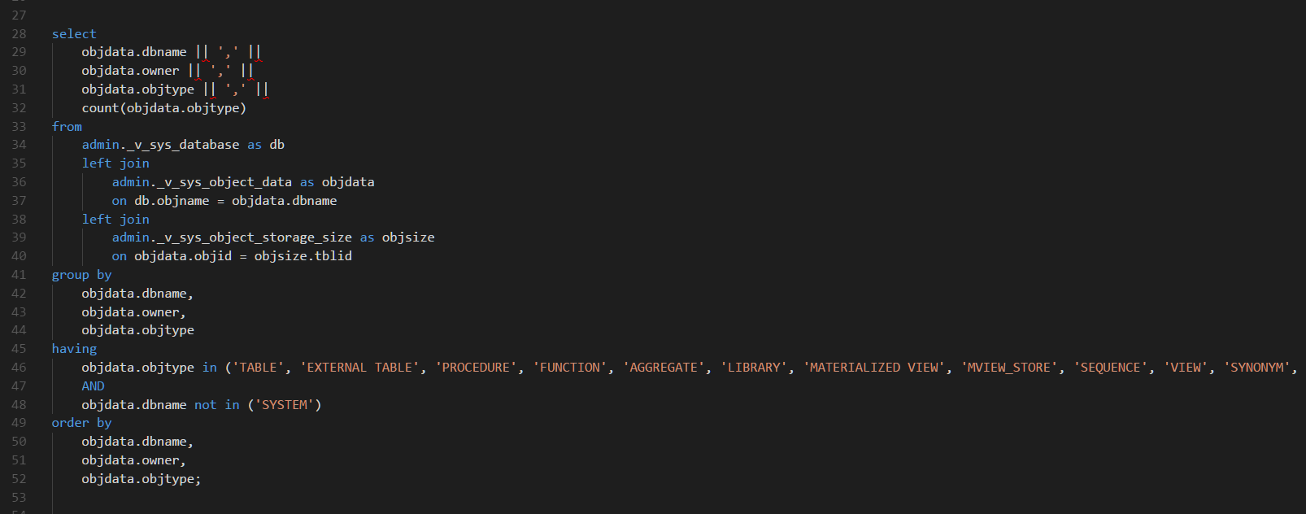
Code Snippet

Slide 6
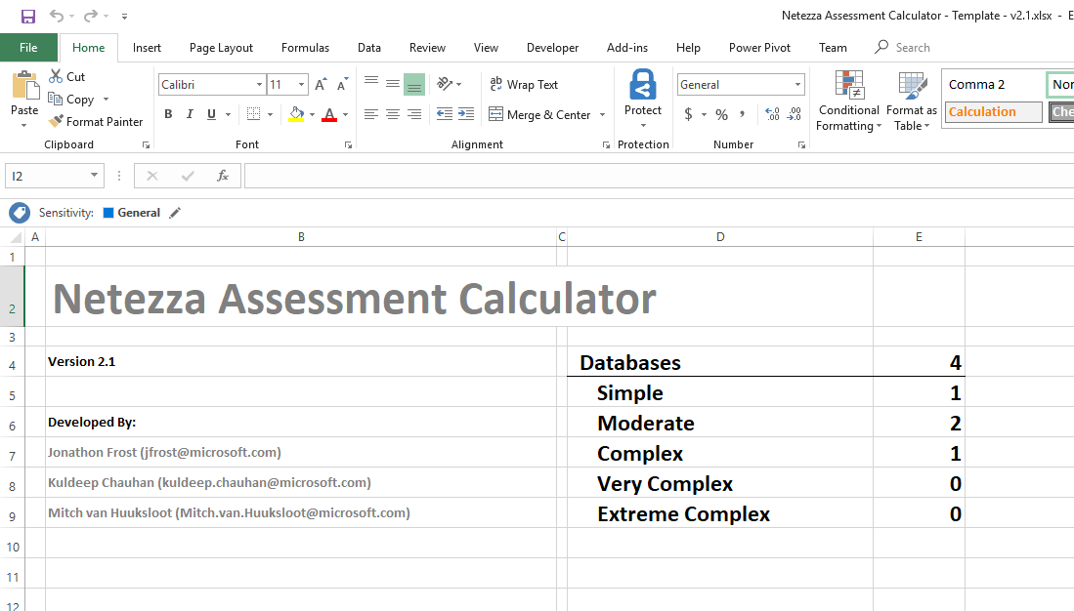
Excel Workbook Calculator Main Tab Dashboard

Slide 7
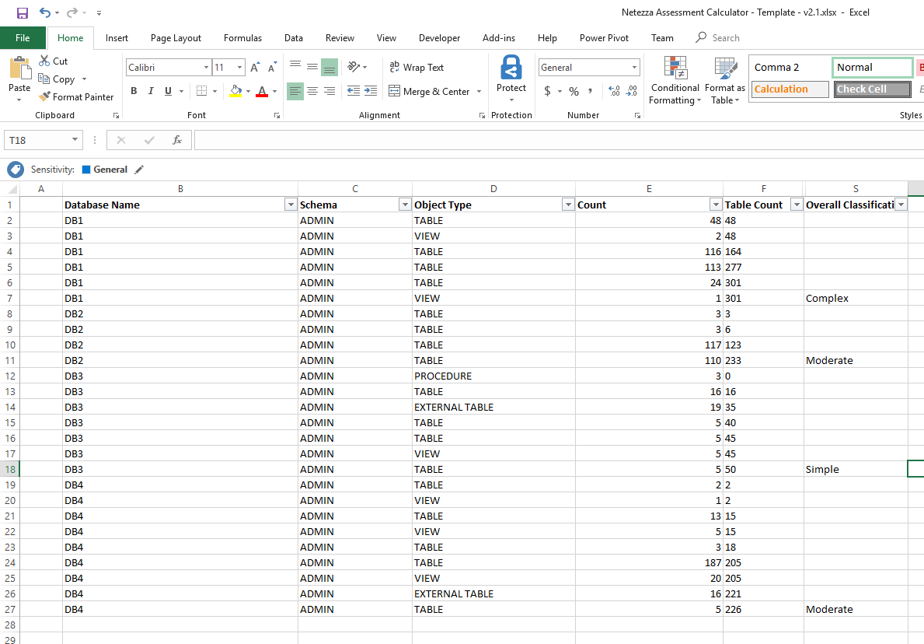
Excel Workbook Calculator Schema Object Tab

